Slide 1
Shortest Path Algorithm
Dijkstra’s Algorithm
Bellman-Ford Algorithm
8
5
3
2
3
5
6
2
8
6
3
3
1
2
2
3
1
4
1
1
2
7
1
4
5
1

Slide 2
Reduced graph
5
3
2
3
5
2
6
1
2
3
1
2
1
4
5
1

Slide 3
Dijkstra’s Algorithm
2
3
2
3
1
D₂ = 2
D₃ = 5
D₂ = 2
D₃ = 4
6
1
6
4
5
4
5
D₄ = 1
D₄ = 1
D₅ = 2
T = { 1 }
T = { 1, 4 }
2
3
D₃ = 3
2
3
D₂ = 2
D₂ = 2
D₃ = 4
1
6
1
6
4
5
D₆ = 4
4
5
D₄ = 1
D₅ = 2
D₄ = 1
D₅ = 2
T = { 1, 2, 4, 5 }
T = { 1, 2, 4 }

Slide 4
Dijkstra’s Algorithm (cont)
Node
D
T
2
3
4
5
6
1
2
5
1
∞
∞
1, 4
2
4
1
2
∞
1, 4, 2
2
4
1
2
∞
1, 4, 2, 5
2
3
1
2
4
1, 4, 2, 5, 3
2
3
1
2
4
1, 4, 2, 5, 3, 6
2
3
1
2
4

Slide 5
Dijkstra’s Algorithm (cont)
w(i, j) = link cost, L(n) = path cost from node s to n
1. [Initialization]
T = {s}
L(n) = w(s, n) for n ≠ s
2. [Get next node]
Find x ∉ T such that L(x) = min L(j)
Add x to T
3. [Update Least-Cost Paths]
L(n) = min [ L(n), L(x) + w(x, n) ] for all n ∉ T
Go to step 2
j∉T

Slide 6
Bellman-Ford Algorithm
D⁽²⁾₃ = 4
2
3
2
3
1
D⁽¹⁾₂ = 2
D⁽¹⁾₃ = 5
1
D⁽²⁾₂ = 2
6
6
4
5
4
5
D⁽²⁾₆ = 10
D⁽¹⁾₄ = 1
D⁽²⁾₄ = 1
D⁽²⁾₅ = 2
h = 1
h = 2
D⁽³⁾₃ = 3
2
3
1
D⁽³⁾₂ = 2
6
4
5
D⁽³⁾₆ = 4
D⁽³⁾₄ = 1
D⁽³⁾₅ = 2
h = 3

Slide 7
Bellman-Ford Algorithm (cont)
Node
D
h
2
3
4
5
6
Source = 1
0
∞
∞
∞
∞
∞
1
2
5
1
∞
∞
2
2
4
1
2
10
3
2
3
1
2
4
4
2
3
1
2
4

Slide 8
Bellman-Ford Algorithm (cont)
L_{h}(n) = path cost from s to n w/ no more than h links
1. [Initialization]
L₀(n) = ∞, for all n ≠ s
L_{h}(s) = 0, for all h
2. [Update]
For each successive h ≥ 0
For each n ≠ s, compute
L_{h+1}(n) = min [ L_{h}(j) + w(j, n) ]
link
s
j
n
<= h links
j

Slide 9
Comparisons
L(n) = min [ L(n), L(x) + w (x, n) ]
L_{h}(x, D)
x
…
……
S
D
S
x
D
x
Dijkstra’s
(Link State)
Bellman-Ford
(Distance Vector)

Slide 10
Bellman-Ford vs. Dijkstra
Results from two algorithms agree
Bellman-Ford
Calculation for node n needs link cost to neighbouring nodes plus total cost to each neighbour from s
Each node can maintain set of costs and paths for every other node.
Can exchange information with direct neighbours
Can update costs and paths based on information from neighbours and knowledge of link costs
Dijkstra
Each node needs complete topology
Must know link costs of all links in network
Must exchange information with all other nodes
Notes:
One interesting comparison can be made between these two algorithms, having to do with what information needs to be gathered. Consider first the Bellman-Ford algorithm. In step 2, the calculation for node n involves knowledge of the link cost to all neighboring nodes to node n ]i.e., w(j, n)] plus the total path cost to each of those neighboring nodes from a particular source node s [i.e., L_{h}(j)]. Each node can maintain a set of costs and associated paths for every other node in the network and exchange this information with its direct neighbors from time to time. Each node can therefore use the expression in step 2 of the Bellman-Ford algorithm, based only on information from its neighbors and knowledge of its link costs, to update its costs and paths.
On the other hand, consider Dijkstra's algorithm. Step 3 appears to require that each node must have complete topological information about the network. That is, each node must know the link costs of all links in the network. Thus, for this algorithm, information must be exchanged with all other nodes.

Slide 11
Routing in ARPANET
First generation(RIP), 1969
Adaptive Routing is adopted
Use Bellman-Ford algorithm → Distance Vector
Estimated link delay is simply the queue length for that link
Every 128ms, each node exchanges its delay vector (routing table) with all its neighbors
Information about a change in network condition would gradually ripple through the network

Slide 12
Routing in ARPANET (cont)
Each node i maintains
d_{i j} = current estimate of min delay from i to j
s_{i j} = next node in the current min-delay route from i to j
Node k updates its vectors as follows
d_{k j} = Min [ l_{k i} + d_{i j} ] i ∈ A
s_{k j} = i using i that minimizes the expression above where A = set of neighbor nodes for k l_{k i} = current estimate of delay from k to i
k
i
j

Slide 13
Routing in ARPANET (cont)
Major shortcomings of RIP
It did not consider line speed, merely queue length. Higher capacity links were not given the favored status
Queue length is an artificial measure of delay
The algorithm was not very accurate. It responded slowly to congestion and delay increases.

Slide 14
Routing in ARPANET (cont)
Second generation, 1979
Using Dijkstra’s algorithm
Link State Routing Protocol
OSPF: Open Shortest Path First protocol
The delay is measured directly
Every 10 seconds, the node computes the average delay on each outgoing link
Information of changes in delay is sent to all others nodes using flooding

Slide 15
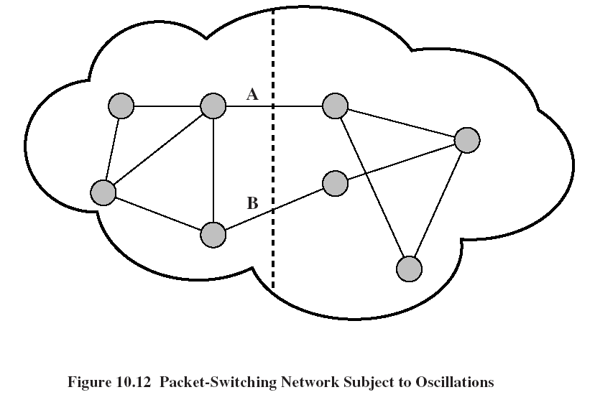
Routing in ARPANET (cont)

Slide 16
Routing in ARPANET (cont)
Third generation, 1987
Problem
The correlation between the reported values (delay) and those actually experienced after rerouting
Conclusion
Under heavy load, the goal of routing should be to give the average route a good path instead of attempting to give all routes the best path
Solution
Also consider the average utilization of links
Revised cost function:
delay-based metric under light loads
capacity-based metric under heavy loads

Slide 17
Calculate Link Costs
Measure the avg. delay over the last 10 sec
Using the single-server queuing model (M/G/1), the measured delay is transformed into an estimate of link utilization
Average the link utilization ρ (n+1) with the previous estimate of utilization U(n)
U(n+1) = 0.5 * ρ (n+1) + 0.5 * U(n)
The link cost is set as a function of average utilization

Slide 18
ARPANET Delay Metrics (3rd)
5
Theoretical queueing delay
4
Delay (hops)
3
2
Metric for satellite link
1
Metric for terrestrial link
0
0.0
0.1
0.2
0.3
0.4
0.5
0.6
0.7
0.8
0.9
1.0
Estimated utilization

Slide 19
ARPANET Delay Metrics (3rd)
Delay is normalized to the value achieved on an idle line
The cost value is kept at the minimum value until a given level of utilization is reached
Reducing routing overhead at low traffic levels
Above a certain level of utilization, the cost level is allowed to rise to a maximum value that is equal to three times the minimum value
To dictate that traffic should not be routed around a heavily utilized line by more than two additional hops

